Slide 1


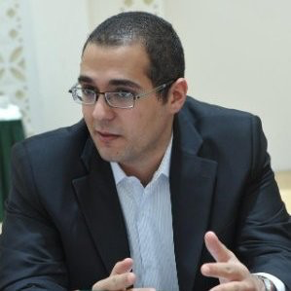

COVID-19 Outbreak Predictor
The socially distant
Stephen Knapp
Li Wang
Guy Bou Lahdou

Slide 2
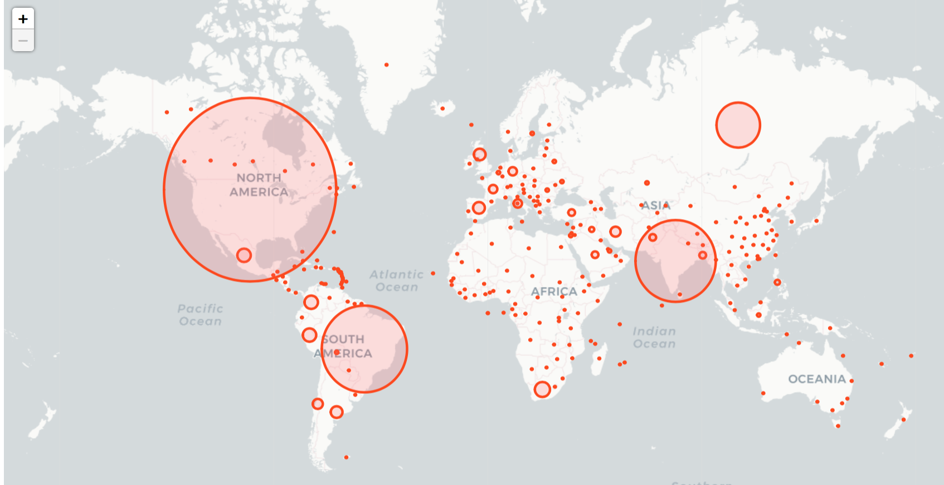
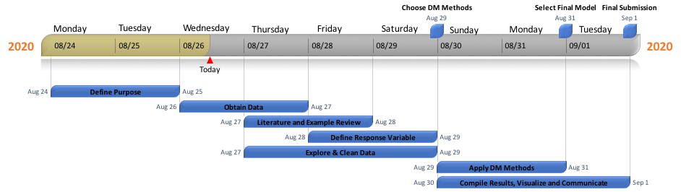
Process/Timeline

Slide 3
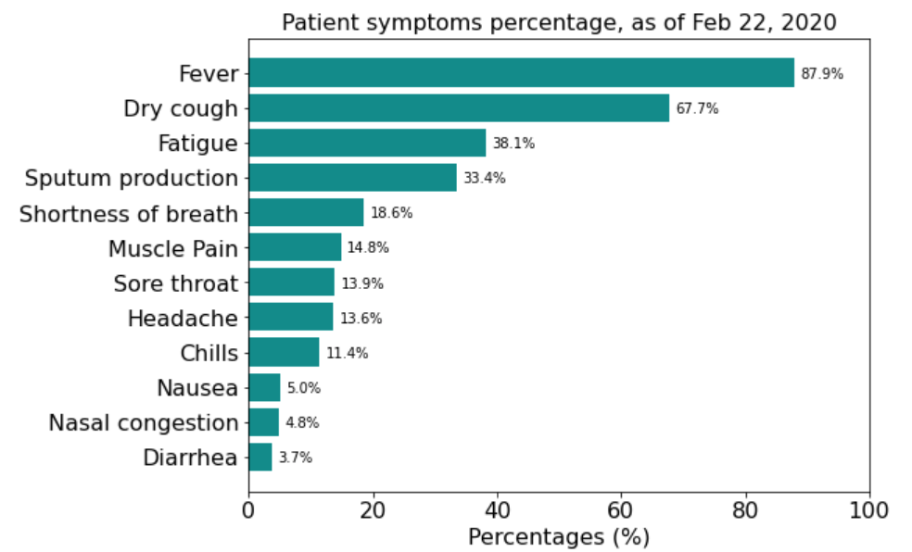
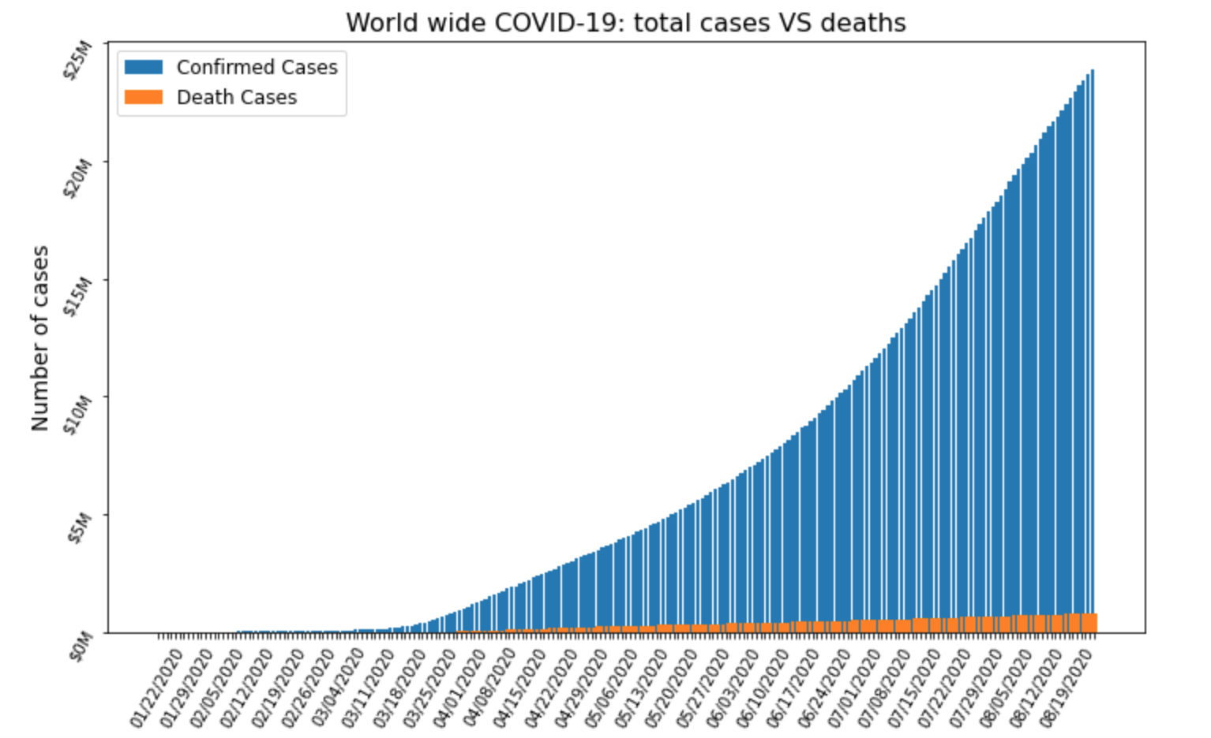
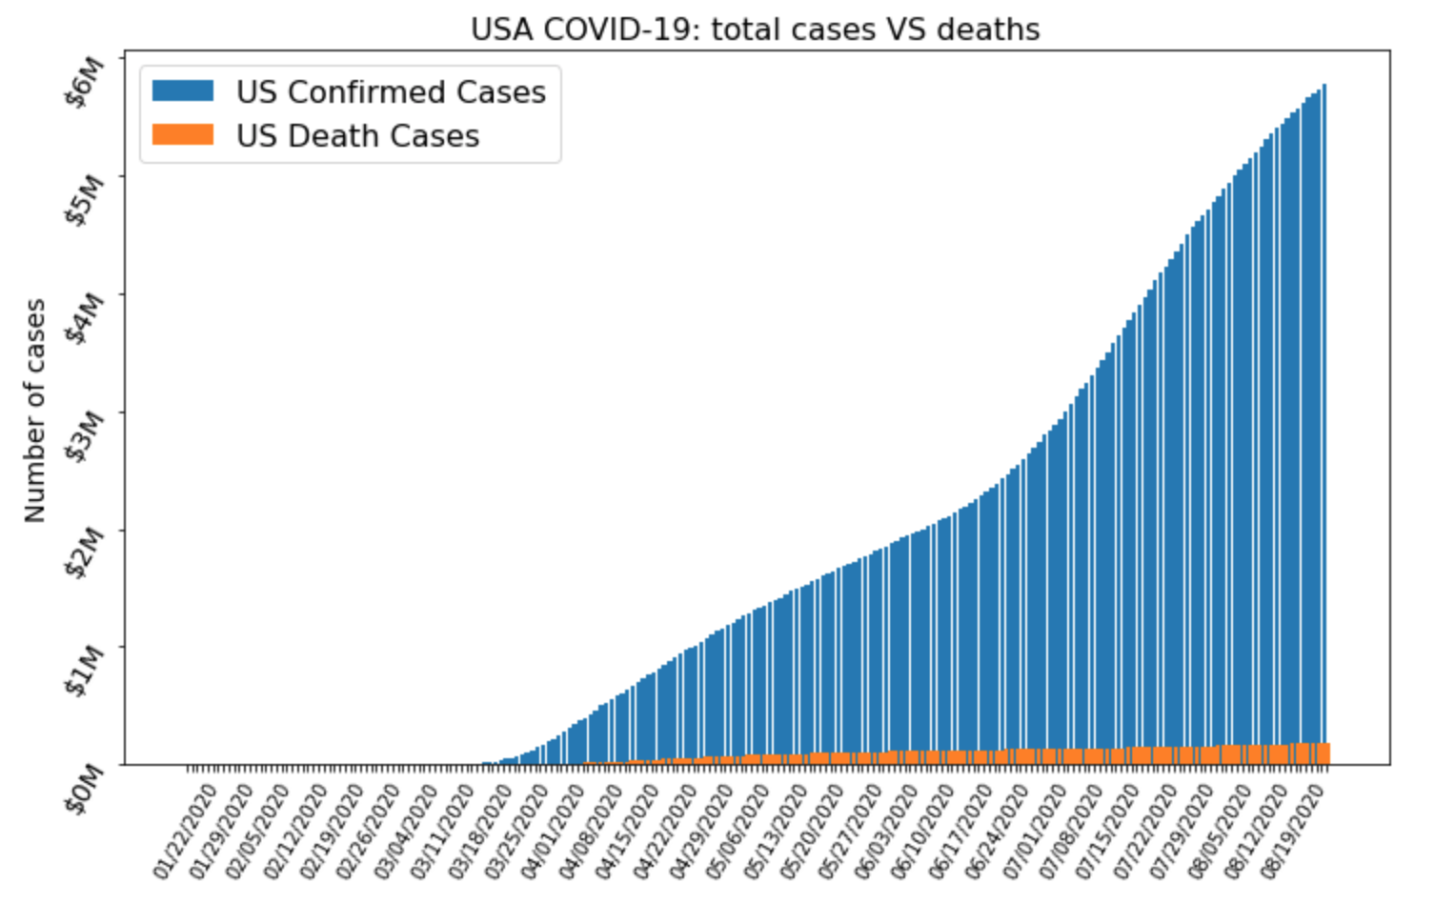
Research Question
What characteristics and interventions efforts
are predictive of a COVID-19 outbreak at the
county level?

Slide 4
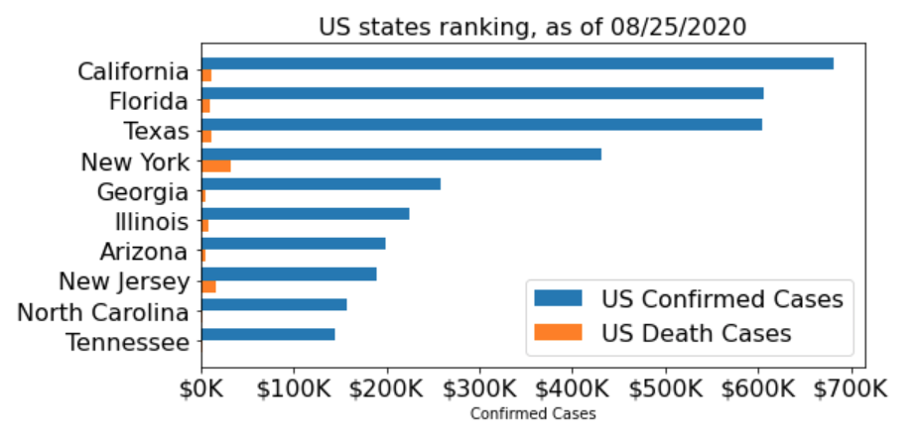
Data Sources, Citations, Cleaning and Enriching
All data sources and links
https://github.com/JieYingWu/COVID-19_US_County-level_Summaries/tree/master/data
https://github.com/CSSEGISandData/COVID-19/tree/master/csse_covid_19_data
https://github.com/Keystone-Strategy/covid19-intervention-data/
Blank data filling: median values from the corresponding columns
Outliers : Capped out based on histogram
55 input variables enriched from raw data

Slide 5
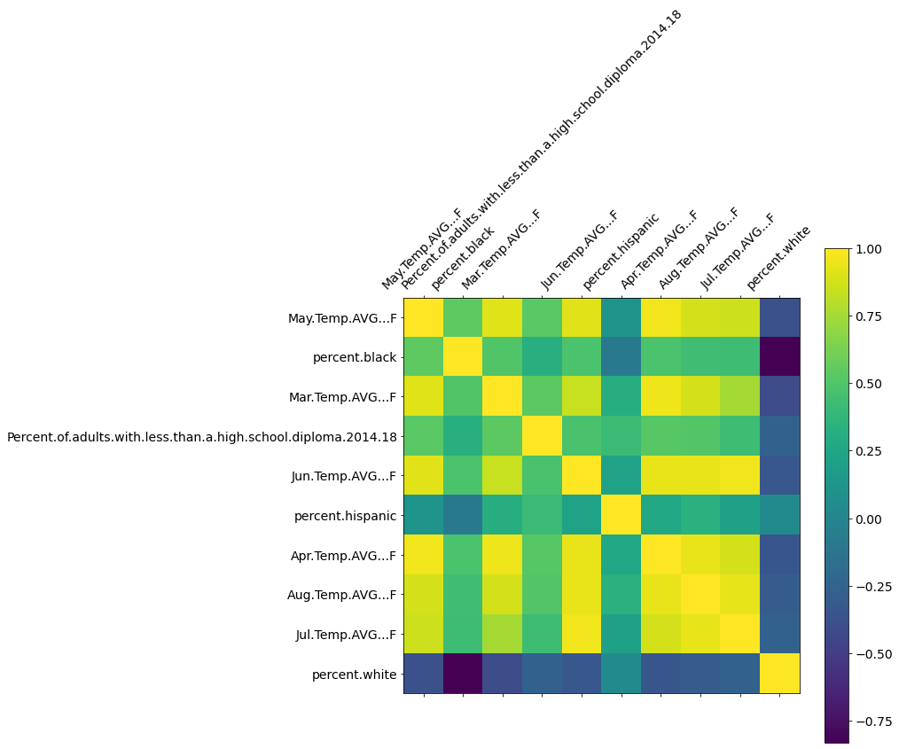
Exploration - County Characteristics
Visualize - social/economic, race, age, pop density, medical capabilities,

Slide 6
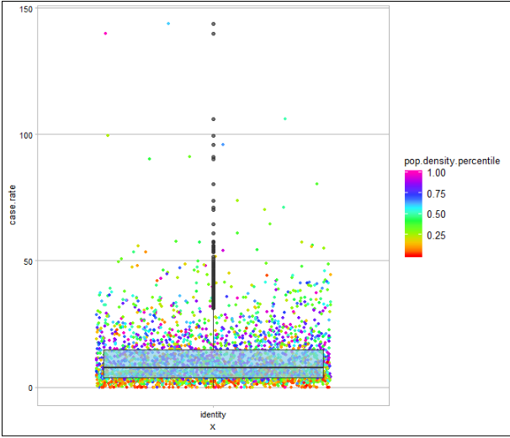
Exploration - County Density

Slide 7
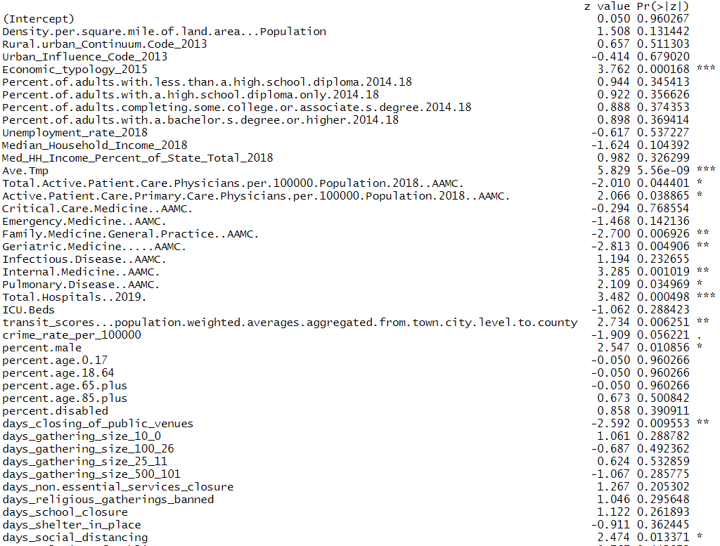
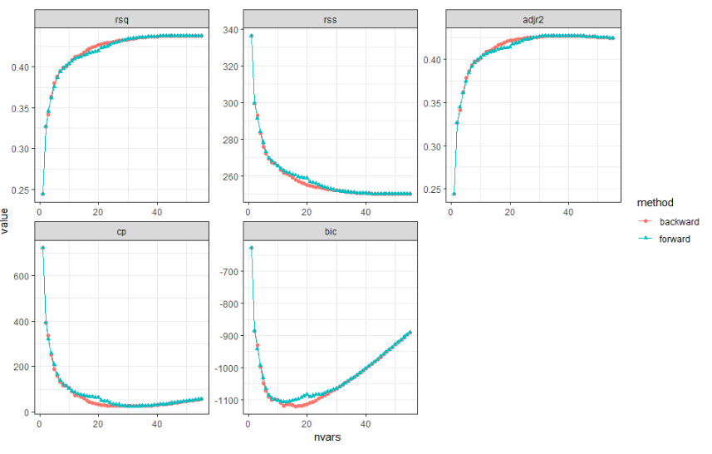
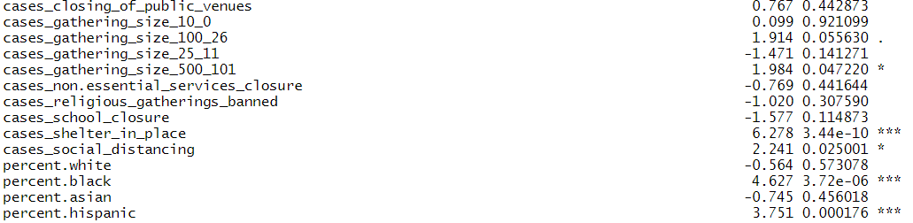
Variable Selection Analysis

Slide 8
Model Set-up
Train:Test was 80:20
Labeling: Each county in the US was ranked rated a 0 if it was in the bottom 75% of case densities and a 1 if it was in the top 25%.
Baseline model performance: Logistic Regression ~85% accuracy
20 input variables
Final Model: Random Forest
Hyperparameters: RandomForestClassifier('max_features': 10, 'n_estimators': 200)
Performance: 87% accuracy

Slide 9
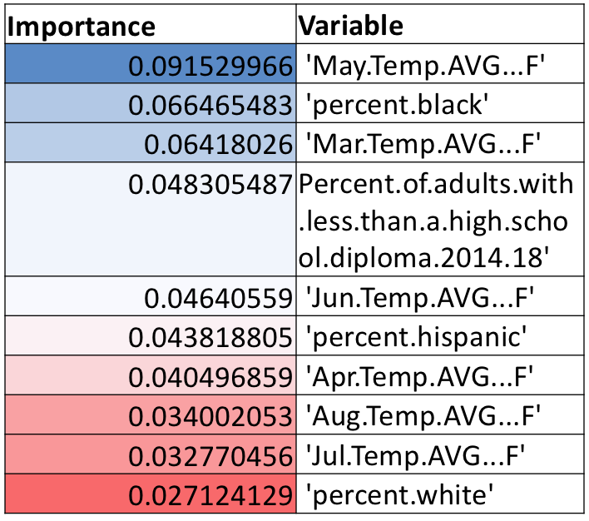
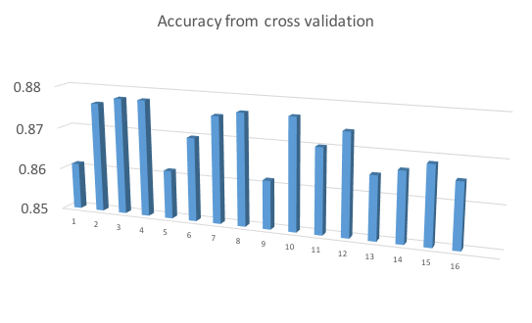
Model Performance
Random forest:
Without standardization: 0.868627775 (0.007)
With standardization: 0.870269616875 (0.006)

Slide 10
Conclusion
Social-economics and health care capacity outweigh interventions
Highly significant county characteristics:
Economic typology
Proportions of black and hispanic residents
Average temperature
Hopital to resident ratio
Significant interventions:
Duration of closed public venues and social distancing order
Case density when shelter-in-place/social distancing orders issued

